Slide 1

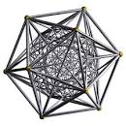
Positive interactions online
enhancing understanding between diverse communities and groups via civil discussions, debates and idea exchange.
Pitch Deck version .54

Slide 2
The Problem: Social Media needs fixing
Social Media have become toxic
maybe anti social at times
No mainstream platform for civil debate
and idea generation

Slide 3
Problem: Online Identity and anonymity
Too much anonymity leads to bad behavior online
Too little anonymity isn‘t good either
it limits discussion
Need a synthesis of opposites

Slide 4
The Problem: Signal to Noise Ratio
Social media trolls get promoted due to ad based revenue
We need not to be sold off to corporations as eyeballs
We should have agency as to what ads we want to see
Untargeted ads = noise / Good ads = signal

Slide 5
The Solution: Tetraplex is the better network
Semi-anonymous social network
with a karma system
Karma promotes pro-social behavior
Reward good behavior with karma

Slide 6
Tetraplex veil: The synthesis
We make it possible to have anonymity via the veil
The veil can be taken off when we need strong identity
You can resume using the veil when needed
Karma gets deducted if you behave badly even with veil

Slide 7
Tetraplex ads: Better Signal to Noise Ratio
You are not a passive eyeball... you can choose your ads!
Less waste for advertiser
Get paid with Karma for watching ads you like
Conclusion: Tetraplex has Better signal to noise ratio

Slide 8
Tetraplex Brainstorm: idea generation
More open discussions even with your boss
Talk with random people and bounce ideas
Idea generation via exchange and synthesis
of opposites

Slide 9
Tetraplex Discuss: Civil debates
Discussion with veil on means you are judged by your ideas
- More open debates with the veil
- Better and civil debates due to karma
- Oxford style debates and voting

Slide 10
Tetraplex Credits: Facilitating interactions
Buy credits from our store with cash
Set bounties with credits for tasks
Earn credits as reward for doing tasks for others
Use credits to direct development
of Tetraplex itself

Slide 11
Tetraplex Kognitivdienste: AI Services
A synthesis of Natural (human user generated)
and Artificial Intelligence (bots crawling the web)
and of statistical inference and logical deduction from
ontological and semantic data.
Tetraplex will give better answers for your questions

Slide 12


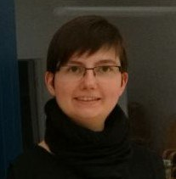
Founding Team / Senior Leadership
Anselm Kiefner,
CEO
Bachelor of Sci
Open Source Author
15+ years with Python
Joel Alcarez,
CSO, Interim CTO
20+ years in IT
Done Startups
Previously
Sarah Geiselhart,
COO
Bachelor of Sci
3 years in Industry as QA and
executive Assistant

Slide 13
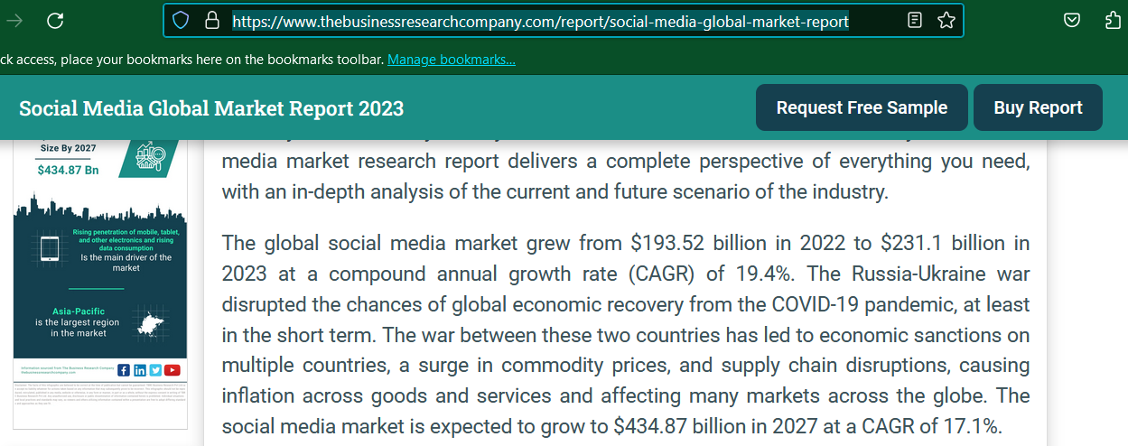
Total Global Social Media Market Size
231.1Billion USD (2023)

Slide 14
Can Tetraplex be a unicorn?
Capture even less than 0.5% of 88 billion USD that’s 1.15 billion USD
Facebook wasn’t the first social media page/app there was MySpace its possible to switch
Tetraplex is definitely not the first but will be less toxic than Facebook or X (former Twitter)

Slide 15
Tetraplex as a future superapp
The West has a lot to catch up with to Chinese superapps
Why Tetraplex as a superapp and not X or a Chinese app?
Because we aim to respect your privacy and not collect too much your data since we will be EU based!
X and Chinese apps have negative press, we don’t…

Slide 16
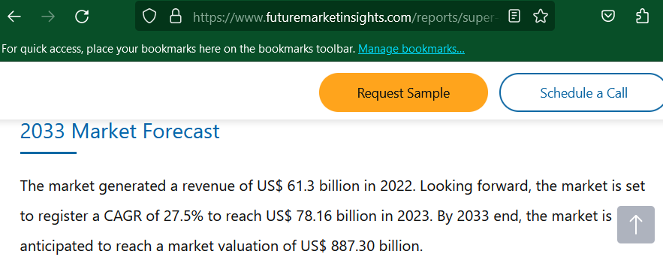
Total Global SuperApp Market Size
887.30 Billion USD (Est. 2033)

Slide 17
Can Tetraplex be a unicorn as a SuperApp ?
Capture even less than 0.002% of 887.3 billion USD by 2033 that’s 1.77 billion USD (Estimated market by 2033)
The Tetraplex credits will be used for everything eventually.

Slide 18
The Conclusion
Join us in our quest for a better social network
Say no to anti-social ad based social networks
Say yes to Tetraplex

